Slide 1
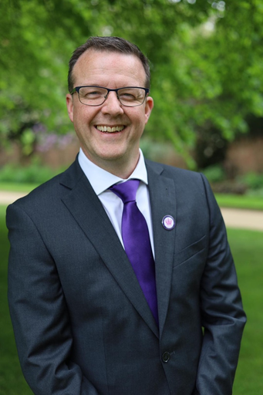


    Martin McAndrew - National Network of Parent Carer Forums Regional Director, North West

Slide 2



What is a parent carer forum?
“Parent Carer Forums are representative local groups of parents and carers of children and young people with disabilities who work alongside local authorities, education, health and other services providers to ensure that the services they plan, commission, deliver and monitor meet the needs of children and families”
Notes:
Official local PCF’s are commissioned by the DFE and their grant is administered and monitored by the charity Contact.

Slide 3
The NNPCF in numbers
9
Regions
10
Regional Directors/Board Members
3404
Different Activities
1170
Days of work
69
Workstreams
153
Member forums
154,950
Parent Carers
Notes:
The local forums are supported nationally by the NNPCF (national network of parent carer forums). The NNPCF not only support local forums through their regional directors but also carry out the same function as a local forum but at a national level with government.

Slide 4
What is co production and why do it?
SEND code of practice
4. Co-production The SEND Code of Practice (January 2015) highlights the expectations of core principles that underpin all legislation and guidance related to SEND: “1.1 Section 19 of the Children and Families Act 2014 makes clear that local authorities, in carrying out their functions under the Act in relation to needs (SEND), must have regard to: • the views, wishes and feelings of the child or young person, and the child’s parents • the importance of the child or young person, and the child’s parents, participating as fully as possible in decisions, and being provided with the information and support necessary to enable participation in those decisions • the need to support the child or young person, and the child’s parents, in order to facilitate the development of the child or young person and to help them achieve the best possible educational and other outcomes, preparing them effectively for adulthood.
NHS constitution
You have the right to be involved, directly or through representatives, in the planning of healthcare services commissioned by NHS bodies, the development and consideration of proposals for changes in the way those services are provided, and in decisions to be made affecting the operation of those services.
Notes:
The boring answer is because we are legally obliged to. But in reality it is because it creates better outcomes and is thew right thing to do.

Slide 5
Why co produce with PCF’s?
Notes:
Co-production with PCF’s is because they are your Co-production experts and are representative of the wider parent/carer experience in your, they are also monitored for quality and adherence to DFE guidelines by Contact, giving assurance of quality.

Slide 6
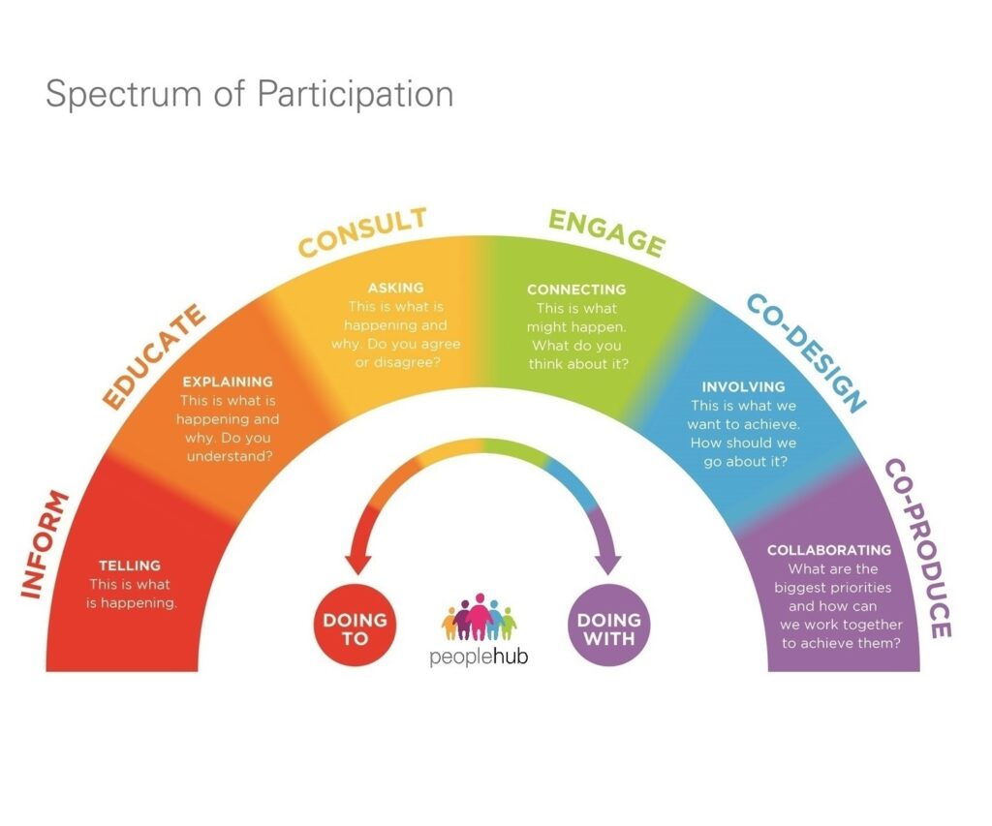

Notes:
All stages of the spectrum should be followed for best practice, but as this is not always realistic we must ensure that there is co-design and co-production at the end even if all steps cannot be followed.

Slide 7
Parent Carer forums Grant Insights and Perspectives from DfE Grant Monitoring 2023/24
Forums are asked to choose an item that best describes their relationship with Education, Social Care and Health.
  Coproduction
  Participation
  Consultation
  Information
  No working relationship
  Other
The results are from 22 forums completed monitoring forms

Slide 8
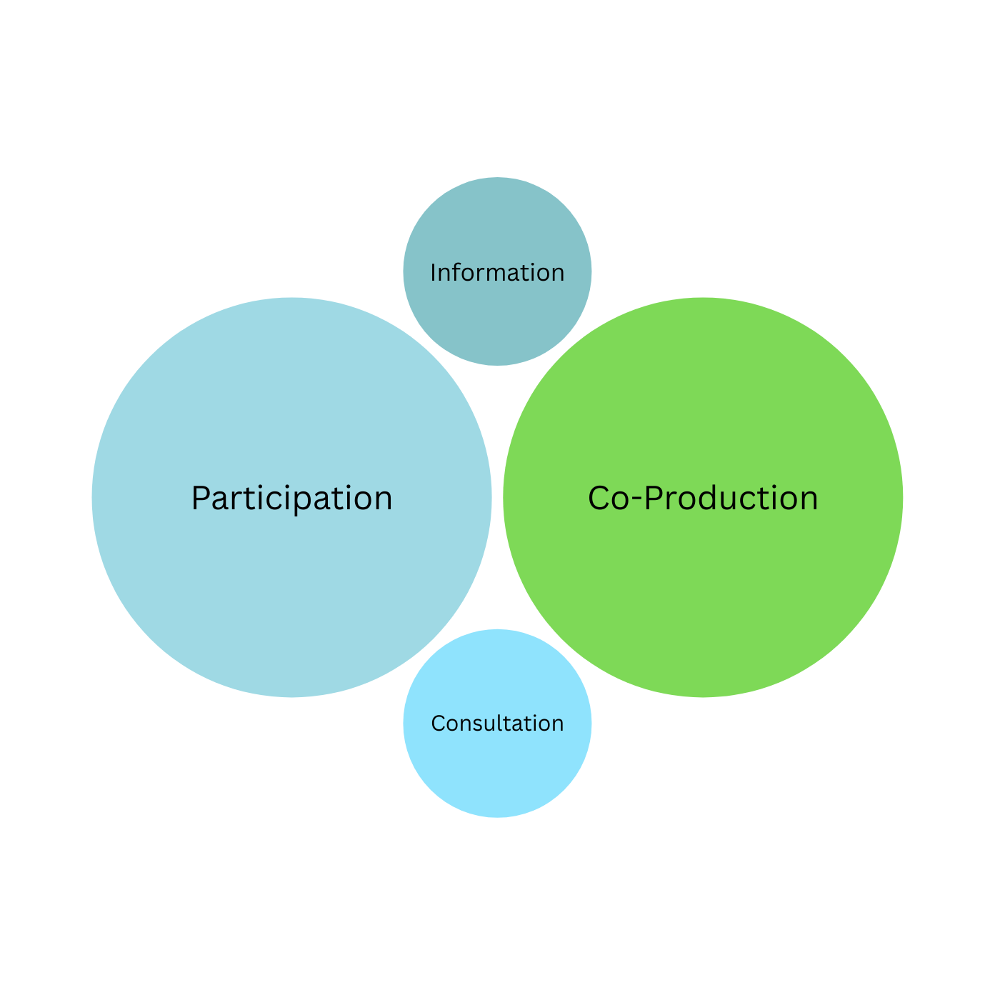
Health
2
9
9
2
Notes:
These figures are to show the monitoring from Contact and the differing experience of PCF’s in different areas

Slide 9
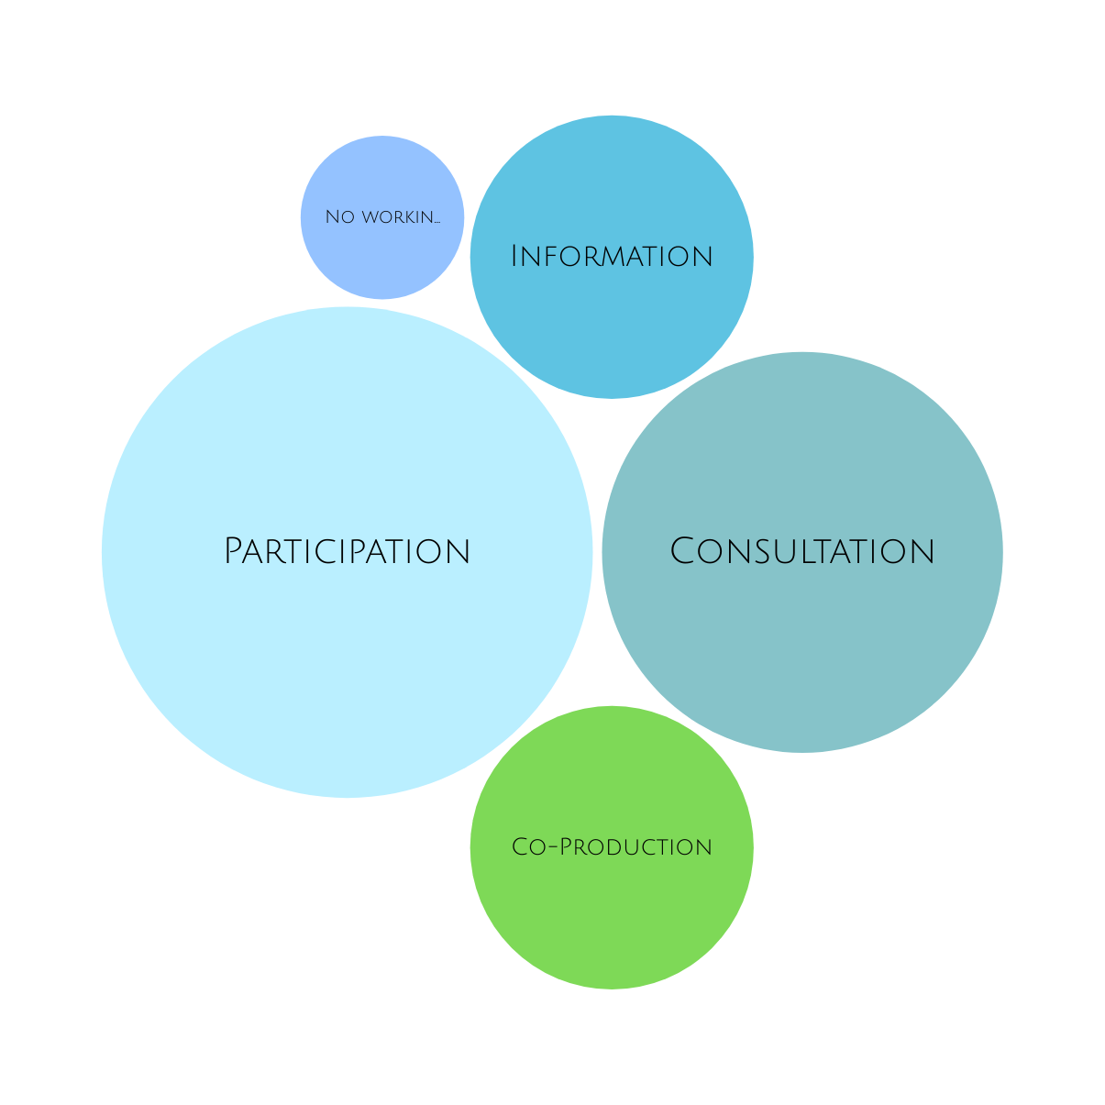
Social Care
1
3
9
6
3

Slide 10
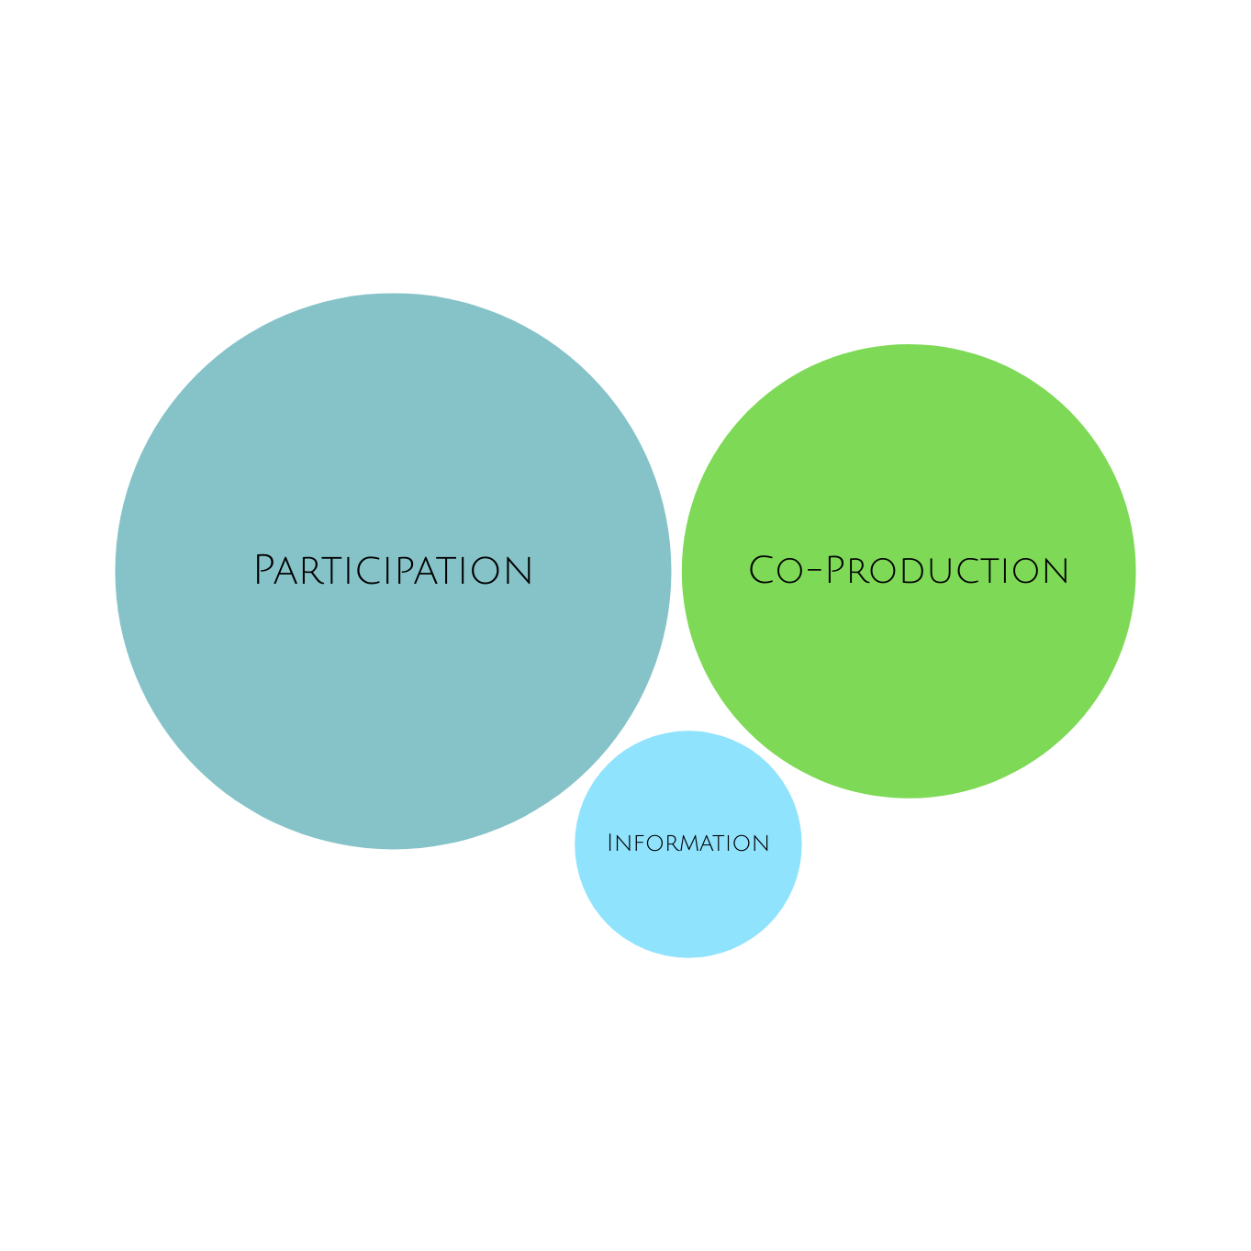
Education
12
8
2

Slide 11

Challenges
Times of meetings
Cancellation of meetings
Capacity
Changes in Staff
Not being involved in Decision Making
Jargon Acronyms
Other Parent Carer Groups
Notes:
As all forums are run by volunteer parent carers these are some (but not all) of the challenges we face. PCF’s are generally available during school hours term time as they will all have children with SEND that they have caring responsibility for. Late canx can cause issues as all are unpaid volunteers. Changes in staff as co-production relies on relationship building and trust. Not being there when a decision is made or not being involved is not co-production. Please keep jargon and acronyms to a minimum. Other parent groups whilst valid and can be supportive for parents should not be used as official co-production partners as they cannot be guaranteed to be representative or monitored for quality like a PCF.

Slide 12



Achievements
We work very closely with our DCO who is passionate about co-production and hearing from parents. This year this has heavily influenced work on the ADHD pathway, ASD pathway, diagnosing learning disabilities and PFA.
Our Director of Education and the Executive Director of Children Services are keen to hear parent carers voices and will schedule meetings as needed to discuss parent carer concerns and look for ways to address these,
Directly quoted acronyms
DCO Designated Clinical Officer
ADHD Attention Deficit and Hyperactivity disorder
ASD Autism Spectrum Disorder
PFA Preparing for Adulthood
Notes:
Some PCF feedback and an example of how to manage Jargon and accronyms

Slide 13



It is getting better
with the DSCO in place
We have representation on Strategic meetings, attend events with partners and hold a fortnightly keeping in touch meeting to discuss any issues with health, education and social care.
We are asked to attend all meetings prior to anything being co-produced rather than being asked to look at documents. We are involved in creating them such as the SEND strategy and other up-and-coming documents. We feel that our opinions and lived experience are very much appreciated and heard within services and the LA,
Notes:
Call it what it is

Slide 14
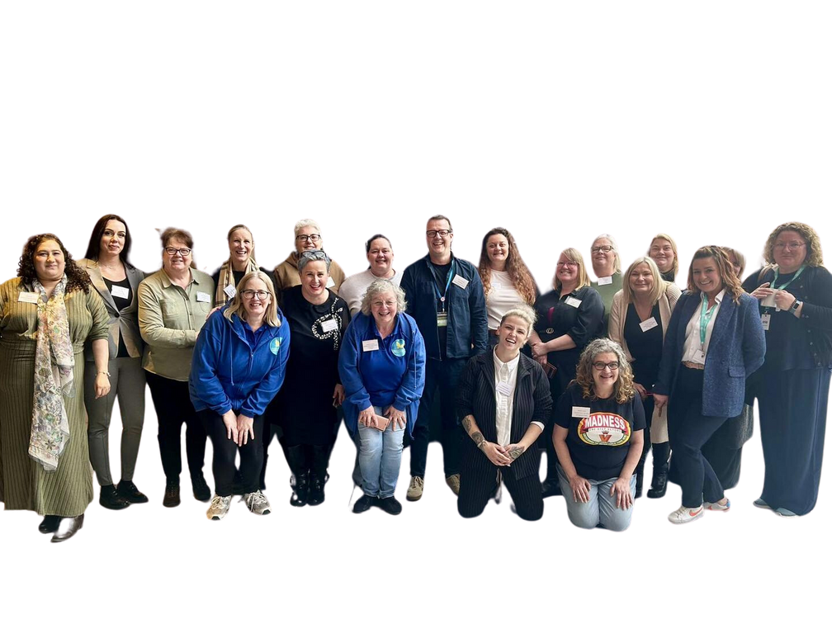

Successful Relationships
comes from committed relationships
Not a one night stand
Notes:
Genuine co-production takes time requires trust and good relationship building

Slide 15


Reflections
Blank piece of paper?
Children and Young People with SEND & their families at the heart
Golden Thread
Relationships
No need to reinvent the wheel
Understanding strategic partnership
Funding
Notes:
These are examples of what good co-production can look like and some of the barriers to it.

Slide 16
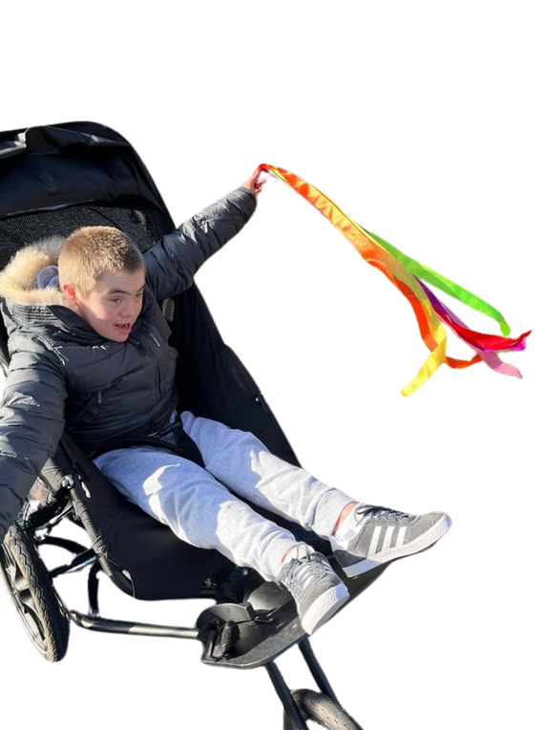
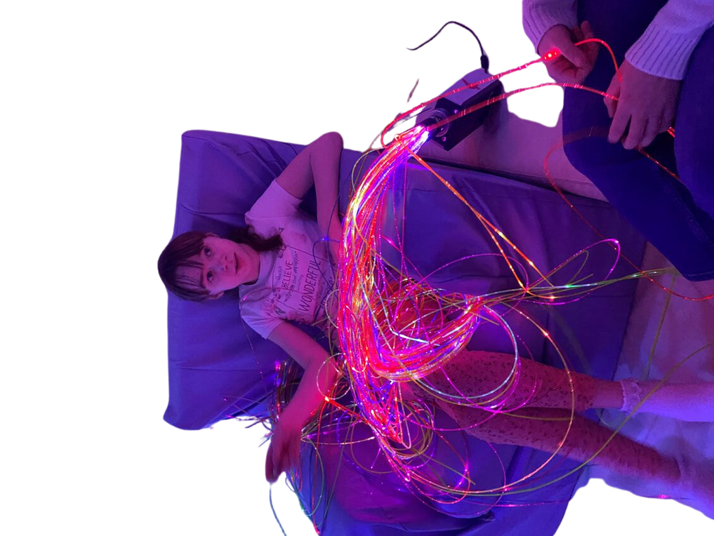



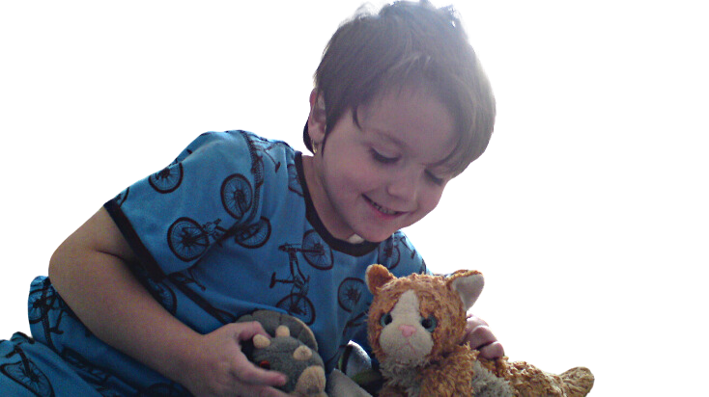
GOLDEN THREAD
Notes:
The golden thread is that the child/YP should be at the centre of everything and it is for us to tie all the support together to meet their and their families aspirations.

Slide 17

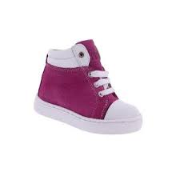

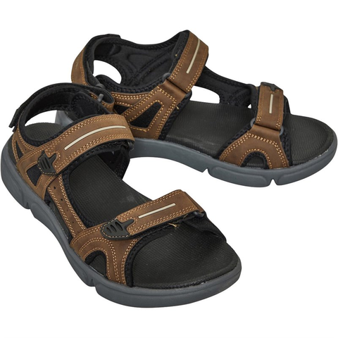





Notes:
This is to illustrate that we all would choose a different shoe and that it may be different depending on the task.

Slide 18


If you want to know how well a pair of shoes fit
you ask the person wearing them
not
the person who made them
or
paid for them
Notes:
This speaks for itself.

