Slide 1
Slide title goes here
Strengths Based Practice Training
Module 1 - Awareness
Notes:
Welcome to SBP Training Module 1 – you will notice during the presentation there are icons on the slides you need to click on to play the voice over which will talk you through the slides. Not all need a voice over but where further explanation is required we have added this for ease.
We hope you enjoy the module.

Slide 2
Strength Based Awareness Training
We focus on the Care Act and its legal implications and discuss other relevant acts and legislative framework.
Look at Wellbeing and how Strength Based Practice starts with wellbeing and the wider determinants of health.
What Strength Based Practice is.
We explore some challenges and opportunities of working this way and how you can approach coproducing solutions alongside the person using our services and their families.
Notes:
This slide provides a brief overview of the SBT Practice Awareness Module 1
If you are unsure of which modules you need to undertake, as guidance, please note the below – if you remain unsure please confirm with your line manager or email support via the training portal: -
- For colleagues that do not have contact (direct/indirect) with the local population in your work roles you will only need to undertake Awareness training.
- For staff working directly or indirectly with our local population you will need to complete the awareness plus the practitioner training programmes modules 2,3,4 and 5.

Slide 3
The Strengths-based Approach
Introduction to Strengths-based Awareness Training by Bev Johnson Principal Social Worker, at Bury Council.
Notes:
Please play the video by clicking on the slide play button
Please note that there are other slides that have a speak over function – please click on the bottom left speaker icon where this is visible to play this.

Slide 4
What is a Strengths-based Practice Approach
A simple phrase that has different meanings for different people, but an approach that when done right opens up many possibilities.
This is nothing new, it's a core principle of health & Social Care
A strengths-based approach can be used in any intervention, in any setting, with any person or group, including carers, and by any social or health care member of staff including our volunteers.
© Copyright April 2024
Notes:
This is nothing new. It’s a core principle of health & social care.
‘A strengths-based approach to care, support and inclusion says let’s look first at what people can do with their skills and their resources – and what can the people around them do in their relationships and their communities. People need to be seen as more than just their care needs – they need to be experts and in charge of their own lives.’
(Alex Fox, CEO Shared Lives)
This is nothing new. It’s a core principle of health & social care and lots of practitioners have been working in this way as its shifts from working in a deficit model, whereby the focus is on the person’s problems and what they are unable to do. A deficit model is stigmatising and with some people, can perpetuate feelings of helplessness and defeat.

Slide 5
Core Principles Underpinning Strength Based Approaches
Community / Social inclusion
Opportunity
Wellbeing
© Copyright April 2024
Notes:
Key Message – What's working How can we support you
Social inclusion, opportunity and wellbeing are core principles that underpin a strengths-based approach. Together they are essential to building better health and social care.
But where has the drive to implement a Strength Based Practice Approach come from – Care Act is one of the biggest drivers for this approach alongside the Mental Capacity Act.
Strengths-based Approach
A simple phrase that has, different meanings for different people but an approach that when done right opens up many possibilities.
A strengths-based approach can be used in any intervention, in any setting, with any client group, including carers, and by any social or health care member of staff
Notes
At the heart of this change is the focus on a ‘Strengths based approach’ (or what some people call an ‘asset based approach’). This is nothing new. It’s a core principle of social care.
There are many definitions of what strengths-based approach is. We are not attempting to give a comprehensive reference to all
‘A strengths-based approach to care, support and inclusion says let’s look first at what people can do with their skills and their resources – and what can the people around them do in their relationships and their communities. People need to be seen as more than just their care needs – they need to be experts and in charge of their own lives.’
(Alex Fox, CEO Shared Lives)
This is nothing new – a lot of practitioners have been working in this way
Working in this way, shifts from working in a deficit model, whereby the focus is on the person’s problems and what they are unable to do. A deficit model is stigmatising and with some people, can perpetuate feelings of helplessness and defeat.

Slide 6
The Care Act 2014 – 7 step approach
The main aim of the Care Act is to promote people’s wellbeing and independence, which is broader than meeting eligible needs.
Which puts a strengths-based approach at the centre of any intervention, placing the individual, at the centre of the process and highlights ‘what is working, what can we do to support you' identifying the resources some has within themselves as well as who and what support they have around them
This ensures that all their strengths and talents are identified and considered in all interventions: not just their needs and personal outcome such as what is important for them or what would they like to achieve.
© Copyright April 2024
Notes:
Concept of Strengths-based approach under the Care Act 2014. The main aim of the Care Act 2014 is to promote people’s wellbeing and independence.
Care Act promote a 7 Step approach : -
Step 1 – Information & Advice -provide information and advice as this can sometimes be enough
Step 2 – Prevention & delay – i.e. give information and advice plus if they are not able to access / do it for themselves make a referral on their behalf this might be to services provided in the community via the Voluntary Sector i.e. Age Concern or to Equipment & Adaptations
The above two steps are around early intervention & prevention.
Step 3 – Care Act Assessment where we move into the conversation about What is not working what can we support you with
Step 4 and 5 – risk assessment/equipment and adaptations – do they need equipment/adaptations to help maintain independence
Step 6 – universal services e.g. weight management groups, stop smoking groups
Step 7 –referral for care act assessment
Its about a different conversation, change of language and approach.
As individuals we are all different, and the Care Act recognises this
This ensures that all their strengths and talents are identified and considered in all interventions: not just their needs and personal outcome such as what is important for them or what would they like to achieve.
As individuals we have multiple skills, knowledge, talents, character traits, relationships and abilities. Social care interventions should consider all of those rather than a ‘one size fits all’ based on the catch-all labels such as ‘disability’, ‘dementia’ or simply ‘old’.
When we look beyond these labels amazing potential is revealed
Interventions become holistic, person-centred and outcome focused, which are key elements for a strengths-based approach, and will result in better outcomes and lives for individuals.

Slide 7
Building on the principles of the Mental Capacity Act
Fully participating in the conversation
There are occasions when people can’t participate in the conversation as fully as it is desirable.
For example, the individual may: -
lack capacity’,
be ‘overwhelmed by the circumstances’,
lack insight into their problems’, or
have cognitive problems that pose a barrier to their understanding and communication skills’
© Copyright April 2024
Notes:
Mental Capacity Act states that people have the capacity to make decisions, can be supported to make the decision
Key principles are:
The importance of beginning with the assumption that the individual is best-placed to judge the individual’s wellbeing. Building on the principles of the Mental Capacity Act, we should assume that the person themselves knows best their own outcomes, goals and wellbeing.
We should not make assumptions as to what matters most to the person.
In all these cases, the social worker or social care practitioner should look at what is getting in the way of the individual to ‘fully participate’ and take the necessary steps to overcome as many barriers as possible. Professionals must ensure that all the appropriate and necessary tools (i.e. independent advocates, mental capacity, specific times or locations, communication aids, short visits, other professionals, etc.) are used to maximise the involvement of the individual in the process and their ability to engage in the conversation

Slide 8
Fundamental change
MOVE FROM
Deficit model
Focused on illness and what cannot do
Eligibility criteria
Resource management
Provide services
Professional as expert
MOVE TO
Maximise involvement
Focus on outcomes
Promote wellbeing
Promote Strengths
Realistic/achievable aspirations
Individual as expert about own needs
© Copyright April 2024
Notes:
Moving away from a deficit model where we only see problems to a model that first looks at what an individual can do.
There is a fundamental link between the core duty in the Care Act –promote individual wellbeing and a strengths-based approach

Slide 9
What do we mean by Wellbeing?
Wellbeing is a broad concept – what does wellbeing mean to you?
© Copyright April 2024
Notes:
There is a fundamental link between the core duty in the Care Act –promote individual wellbeing- and a strengths-based approach
What are the things make you feel good reduce stress and pressure make you feel happy. We all have different triggers – exercise for some other a duvet day and good film.
The aim of promoting individual wellbeing is to ensure that individuals have meaningful lives – the focus should not be only to meet eligible needs.
Exercise – What are the 9 area’s of well being as per the Care Act?

Slide 10
Wellbeing
Nine areas of wellbeing as per the Care Act 2014
Wellbeing should be seen as the common theme around which care, and support is built at local and national level.
It is useful to look at these areas during a strengths- based conversation
:
Notes:
A local authority can promote a person’s wellbeing in many ways. How this happens will depend on the circumstances, including the person’s needs, goals and wishes, and how these impact on their wellbeing. There is no set approach – a local authority should consider each case on its own merits, consider what the person wants to achieve, and how the action which the local authority is taking may affect the wellbeing of the individual.
Both research and practice show that a crucial dimension of wellbeing is the ability and opportunity to benefit from and contribute to one’s own community.
This involves everybody - from people using services, to their carers and friends, and the practitioners supporting them, to understand what this approach means and how it supports assessment and eligibility.
The wellbeing principle applies equally to those who do not have eligible needs but come into contact with the system in some other way (for example, via an assessment that does not lead to ongoing care and support) as it does to those who go on to receive care and support, and have an ongoing relationship with the local authority. It should inform the delivery of universal services which are provided to all people in the local population, as well as being considered when meeting eligible needs. Although the wellbeing principle applies specifically when the local authority performs an activity or task, or makes a decision, in relation to a person, the principle should also be considered by the local authority when it undertakes broader, strategic functions, such as planning, which are not in relation to one individual. As such, wellbeing should be seen as the common theme around which care and support is built at local and national level.

Slide 11
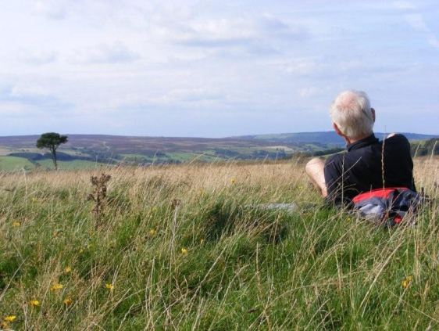
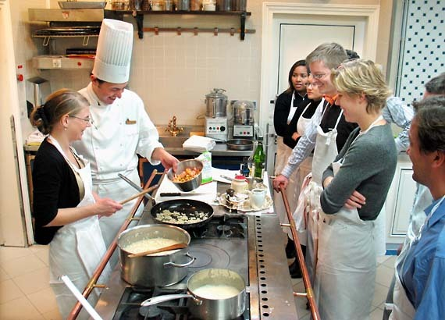
5 Ways to Well-being
Connect…
Take notice…
Be active…
with everyone around you. With family, friends, neighbours and colleagues. Invest time in developing these cornerstones of life.
Be curious. Catch sight of the beautiful. Remark on the unusual Be aware of the world around you.
Exercise is essential for slowing age-related cognitive decline and for promoting well-being.
Seeing yourself and your happiness, linked to the wider community can be incredibly rewarding and creates connections.. Do something nice for someone
Try something new. Rediscover an old interest. Sign up for that course
Keep learning…
Give…
Notes:
Connect
There is strong evidence that indicates that feeling close to, and valued by, other people is a fundamental human need and one that contributes to functioning well in the world.
It’s clear that social relationships are critical for promoting wellbeing and for acting as a buffer against mental ill health for people of all ages.
Be active
Regular physical activity is associated with lower rates of depression and anxiety across all age groups.
Exercise is essential for slowing age-related cognitive decline and for promoting well-being.
Take notice
Reminding yourself to ‘take notice’ can strengthen and broaden awareness.
Studies have shown that being aware of what is taking place in the present directly enhances your well-being and savouring ‘the moment’ can help to reaffirm your life priorities.
Heightened awareness also enhances your self-understanding and allows you to make positive choices based on your own values and motivations.
Take some time to enjoy the moment and the environment around you
Learn
Continued learning through life enhances self-esteem and encourages social interaction and a more active life.
Anecdotal evidence suggests that the opportunity to engage in work or educational activities particularly helps to lift older people out of depression
Give
Participation in social and community life has attracted a lot of attention in the field of wellbeing research.
Individuals who report a greater interest in helping others are more likely to rate themselves as happy.
Research into actions for promoting happiness has shown that committing an act of kindness once a week over a six-week period is associated with an increase in wellbeing

Slide 12
Change starts with you
What do we think resilience means and do we always feel resilient – if not why not?
How do we build & maintain our own resilience?
Looking back how did COVID affect you, did you do things differently or change?
Notes:
What have individuals put in place to look after themselves / build resilience.
Things we can do: -
Look after ourselves and remember what is important.
Do our own asset map and build on it to maintain our resilience
Don’t see crises as insurmountable problems - Keep things in perspective
Accept change is part of living
Learning from mistakes
Recognising emotions – you don't own others’ emotions if they are crying or shouting
Set realistic goals and move towards them
Look for opportunities for self-development
Develop a positive self-view
Maintain a positive outlook

Slide 13
Strengths-based Approach is
Person – centred
Utilises the environment – including the family to get things done
Recognises an asset to be anything e.g., people, buildings, networks, associations etc
Notes:
The strengths-based approach starts with the premise that all of us have something to offer, including people who need support to participate fully in the community, and even people nearing the end of their lives.
About enabling people to find the best solutions for themselves, to support them in making independent decisions about how they live .
The strengths-based approach will in many places result in a cultural shift, with health and social care focusing on the person’s strengths and abilities. It means thinking positively about people who need care and support as well as engaging with the community to reduce isolation and draw those with care and support needs further into community networks. The strengths-based approach is about reducing dependency and challenging ‘prescription culture’.
Crucially, it is about protecting and promoting the person’s independence, resilience, choice and wellbeing. And using the Care Act 3 step approach we should be looking at what’s not working how can we support you - emphasises the use of professional engagement and judgement, as opposed to procedural approaches

Slide 14
Strengths-based Support

Slide 15
Strengths-based Approach
Individual
Their Life
How they would like it to be?
What is impacting on the quality of their life?
How can we support to improve the quality?
Notes:
As individuals we are all different, and the Care Act recognises this. As individuals we have multiple skills, knowledge, talents, character traits, relationships and abilities.
Interventions become holistic, person-centred and outcomes focused, which are key elements for a strengths-based approach, and will result in better outcomes and lives for individuals.
Social workers and social care professionals must build a trusting relationship with the individual where they can show empathy whilst maintaining the necessary professional objectivity. It is not about providing ‘made up solutions’ or ‘fixing’ problems/deficits, but enabling people to live the lives they want to lead.
This cannot be done in a prescriptive or rigid way because individuals and their circumstances are different (i.e. have different strengths, networks, resources, desires, etc.) even if affected by the same ‘disability, impairment or illness’. It isn’t about services either; it is about meaningful lives, it is about the individual and their social and family networks and their communities and how all of them link together maximising outcomes for individuals. Community social work and community development are fundamental in strengths-based approaches.
Please note that the MS teams channel refers to Bury Council staff only.

Slide 16
Elements of a Strengths-based Approach

Slide 17
Strengths-based v Deficit based
Deficit Based
Problems
Blame
What’s missing
Scarcity
Needs
Control-outside in
Top Down
Do to
Passive receivers
CAN’T DO
Strengths Based
Possibilities
Shared ownership
What’s there
Abundance
Courageous leaders
Strengths, capacities assets
Citizen led
Do with, enable
Active producer & co-producers
CAN DO
© Copyright April 2024
Notes:
Working in this way, shifts from working in a deficit model, whereby the focus is on the person’s problems and what they are unable to do. A deficit model is stigmatising and with some people, can perpetuate feelings of helplessness and defeat.
Conversely, a strengths-based model is empowering and starts with what's not working. Whist the persons condition and situation is acknowledged, they are not defined by their illness, their condition or their disability.
A strengths-based model fosters hope and supports the person to reflect on what they want to achieve and what techniques may have been successful for them in the past. It also, allows the practitioner to get to the heart of the person and understand their individuality, strengths, wishes and priorities. What had they previously enjoyed doing? What level of independence did they once have? What aspirations for their life do they have?
This approach prompts a curious conversation approach – being curious listening to what the person is saying and understanding their lived experiences.

Slide 18
Working Collaboratively
Strengths and assets come in many shapes, sizes and ages
Together exploring what the individual's strengths, needs and personal outcomes are
Having conversations and building relationships
Understanding what is in the community
© Copyright April 2024
Notes:
When we talk with patients / individuals we must create relationships based on a collaborative process that will enable us to explore together what their strengths, needs and personal outcomes are.
We need to move away from asking questions on a form to having a conversation and building a relationship. Move from ‘what problems are you having preparing a meal or getting out of the house?’ to ‘what does a good day look like for you?’
Through a strength -based approach we can support the individual to identify their personal outcomes, their needs, and their strengths, including social and family networks and other universal resources available to them. But we must ensure that outcomes / aspirations are realistic and achievable
We can then work together to identify how the strengths – individual and community resources, can support them to improve their lives. This may be, for example, the local council, their skills or knowledge, a friend, library, neighbour, health club or a social group.
Using these tools people can discover assets and strengths they have or could have access to and that may be through local facilities, professionals or their own talents or those of a friend or family member.
When we, practitioners and individuals work collaboratively, we open up that apparently simple ‘circumstance’ of each individual and unfold a whole world of possibilities.

Slide 19
Co-production
A way of working whereby citizens and decision makers, or people who use services, family carers and service providers work together to create an outcome which works for them all.
The approach is value driven and built on the principle that those who use a service are best placed to help design it.
© Copyright April 2024
Notes:
Co-production can be a slippery concept and if it is not clearly defined there is a danger that its meaning is diluted and its potential to transform services is reduced. At the same time, a definition that is too narrow can stifle creativity and decrease innovation. Definitions and language are important but the move toward co-production needs to be more than just a change in words. There is a danger of wrongly assuming that the right words will be followed by the right actions.
So what is co-production; and what does it mean to us - Co-produce a shared picture of what good looks like and user-friendly ways to track its achievement.
The strengths-based approach encourages people to work together to understand how a person’s care and support needs can be met in different ways - including their own strengths and of those around them, for example, family members and their community.
Assessments should now be about supporting people to take the lead in finding solutions. Recognising their contribution helps to build confidence and strengthens their ability to take control over their lives.
It involves looking at the resources available from the public sector, the private sector, the community and the individual. Schools, libraries, GP Surgeries, social clubs and local businesses should all be considered to see what they can offer.
Co-production is about developing more equal partnerships between people who use services, carers and professionals.
It is important to have an agreed definition between everyone taking part in any co-production activity.
There are key principles for co-production around equality, diversity, access and reciprocity.
Co-production can help make the best use of resources, deliver better outcomes for people who use services and carers, build stronger communities and develop citizenship.
To do co-production, organisations need to make changes to their culture, structure and practice and to regularly review progress
Council is currently building and moving towards a self assessment portal

Slide 20
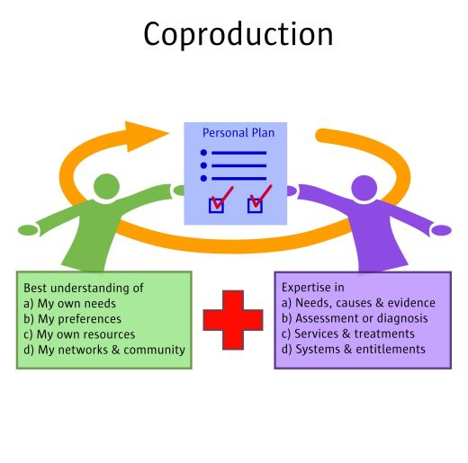
Notes:
So what is co-production; and what does it mean to us - Co-produce a shared picture of what good looks like and user-friendly ways to track its achievement.
The strengths-based approach encourages people to work together to understand how a person’s care and support needs can be met in different ways - including their own strengths and of those around them, for example, family members and their community.
Assessments should now be about supporting people to take the lead in finding solutions. Recognising their contribution helps to build confidence and strengthens their ability to take control over their lives.
It involves looking at the resources available from the public sector, the private sector, the community and the individual. Schools, libraries, GP Surgeries, social clubs and local businesses should all be considered to see what they can offer.

Slide 21
Community Asset Mapping Exercise
Short Exercise: ​
Take some time to consider what community assets you think are available in Bury
Think about your local / community support networks – these can be voluntary groups, clubs, community groups etc.
​
​

Slide 22
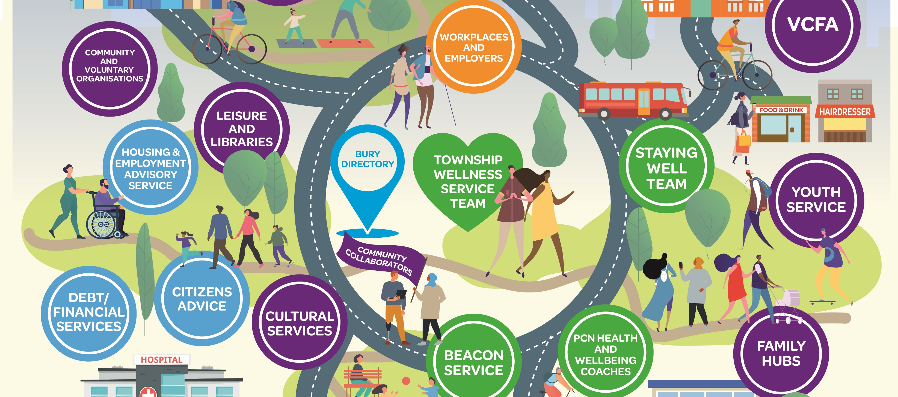
Wellness/ ‘Live well’ Ecosystem
Notes:
This picture shows Bury is full of assets, with organisations and community groups offering support and advice, but this may not always be recognised
Expanding on some of the buttons i.e. VCFA – Age Uk, beacon service, Cultural Services i.e. Prestwich Jewish community services or Radcliff has an mixed ethnic culture East Europeans, Asian who have community clubs, groups etc. Bury Directory has lots of information
You don’t always need to have the answers – it is about helping people It involves looking at the resources available from the public sector, the private sector, the community and the individual. Schools, libraries, GP Surgeries, social clubs, and local businesses should all be considered to see what they can offer.
Benefits
Community led physical activity and wellbeing
Builds community capacity and resilience
Takes pressure off essential services and in the medium term reduces demand and cost for NHS treatment and adult social care.
These can all be utilized when looking at coproducing support / a care plan for an individual

Slide 23
Strengths-based Practice Is
An approach ‘how to carry out’ meaningful conversations with people about what’s working and what they feel could be improved
Holistic & multi- professional where needed “team around the person”
Collaborative – working with people who use our services to help us to deliver better outcomes
Proportionate – we look at what outcomes the person is expecting
Appropriate to the individual circumstances
Aligned with risk enablement and positive risk taking
A focus on ‘what matters to you’ and what is working well
Identifying personal, family and community strengths and support the individual in their community
Supporting community development – identify any gaps in our offer of support
Applicable to all contacts with our services, setting, type or level of need and profession
© Copyright April 2024
Notes:
Having a different conversation
As individuals we are all different, and the Care Act recognises this. As individuals we have multiple skills, knowledge, talents, character traits, relationships and abilities. Social care interventions should consider all of those rather than a ‘one size fits all’ based on the catch-all labels such as ‘disability’, ‘dementia’ or simply ‘old’.
When we look beyond these labels amazing potential is revealed.
A strengths-based approach encourages individuals to make the most of their strengths and abilities and feel part of the process, not separate from it.

Slide 24
Strengths-based Practice is NOT
A prescribed outcome
About reduction of packages of care
About signposting and proving less support
About not offering support
A focus on what is the matter with you and what is wrong
About shifting responsibilities to carers and family/friends
One size fits all (no scripts)
About avoiding talking about the problem or issue
© Copyright April 2024
Notes:
One fundamental point of a strengths-based approach is that it is an ‘approach’, not an outcome or a process. It is less about ‘what the end result is’, or ‘what we do’, and more about ‘how we do things' It is about being aware of the skills we use when we approach individuals, their families and the community to address a particular situation. The aim is to enable better outcomes and/or lives for people, and we should be mindful that not everything that provides better outcomes for individuals is a strengths-based approach.

Slide 25
Strengths-based Practice
Do’s
Don’ts
Use open questions to open up discussions – what’s working well and what could be better
Listen – focus on active listening
Consider why the person is seeking support – it's not always the real reason
Keep up to date with who can help you and where help can be found – if you don’t know ask each other or The Bury directory
Assume
Assume that the person using our services knows nothing even if they think that themselves.
Jump
Jump to conclusions
Don’t make
Don’t make promises that you cannot keep – always be honest and if you don’t have the answer say so.
Resist
Resist trying to push someone into doing something they aren’t ready to do – sometimes you must accept that their life is just that
Notes:
What do you think are the do’s and don’t of SBP?
A strengths-based approach encourages individuals to make the most of their strengths and abilities and feel part of the process, not separate from it.
Social inclusion, opportunity and wellbeing are core principles that underpin a strengths-based approach. Together they are essential to building better health and social care.
The Care Act empowers local authorities and people with care and support needs to work together - to identify and develop strengths and resources to ensure people's needs are met. Effective assessment can help practitioners to understand what's important to the person - as well as their individual strengths, and the resources and networks available to them. A shared understanding of how people can be best supported, and their wellbeing promoted should be encouraged

Slide 26
Summary
Strength-based working is based on the principles of:
Think first about the person and what they can do
Then look at what you can offer to support the individual
What's not working, what could be better and what's already been tried.
© Copyright April 2024
Notes:
A strengths- based approach acknowledges the person's disability and/or illness etc. but shifts the focus to 'the positive attributes of individual lives and of neighbourhoods, recognising the capacity, skills, knowledge and potential that individuals and communities possess. It is based on the fundamental premise that the health and / or social work relationship is one of collaboration, and that people are resourceful and capable of solving their own problems if enabled and supported to do so
Strengths-based approaches are not prescriptive; there is no one-size fits-all model. Approaches recognise that the individual is aware of their situation and the care and support they require. It also aims to ensure that the individual is always at the heart any intervention, is supported to share their views about their own situation and that their family, friends are able to contribute.

Slide 27
Key Learning Points
An understanding of a strengths-based approach and how it can be used in any intervention, in any setting, with any person including carers & family, and by any health or social care member of staff.
An understanding of how people can be best supported, and their wellbeing promoted should be encouraged
Listening to the persons story through a strengths-based lens
Using questions to embed strengths
Notes:
It is a cultural shift – and it’s not going to be straightforward. Practitioners still have to make sure that needs are met and outcomes are achieved in a sustainable way.
It means thinking positively about people who need care and support as well as engaging with the community to reduce isolation and draw those with care and support needs further into community networks. The strengths-based approach is about reducing dependency and challenging ‘prescription culture’. Crucially, it is about protecting and promoting the person’s independence, resilience, choice and wellbeing

Slide 28
What’s next?
Thank you for completing module 1.
We hope you found this is beneficial.
Please remember to complete the quiz questions and the evaluation form on the Training Portal

